Slide 1
Automated irrigation system using IoT
Done by:
C. Prathapan (20BCS043)
B. Raghu Adhithya (20BCS044)

Slide 2
contents
Problem statement
Introduction
Modules used
Circuit diagram
Working

Slide 3
Problem statement
In modern agriculture irrigation is one of the major problems faced by farmers, it is hard to manually track the moisture in the soil and irrigate the land accordingly.
To this we have come up with a solution to automate the sensing of soil moisture and irrigating the land.

Slide 4
Modules Used
ESP32
Relays
Solenoid pump
Motor
Ultrasonic sensor
Soil moisture sensor

Slide 5
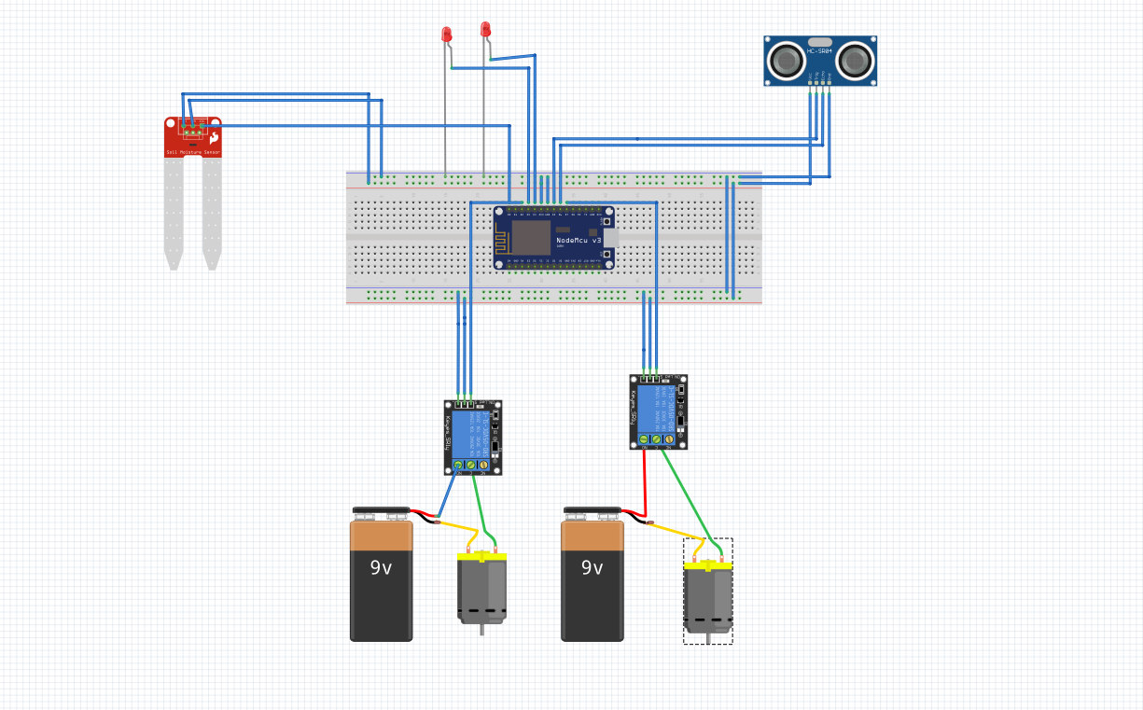
Circuit diagram

Slide 6
Working
Soil moisture sensors are placed all over the land to measure and collect the soil moisture data, this data is sent to the farmers mobile phone using Wi-Fi.
When the moisture level of the soil is below a specified level an LED turns on.
An electrical valve will be placed at an appropriate water source such as a tank and will be turned open when the soil moisture is low, this message will also be sent to the farmers phone using Wi-Fi.
Once the soil is sufficiently irrigated, the valve will be closed and the LED will be turned off and a message that the soil has been successfully irrigated will be sent to the farmer.
To track the water level of the water source we will be using an ultrasonic sensor or a water level sensor. In case of the ultrasonic sensor, the module will be placed above the tank and will track the distance of the surface of the water and the top of the tank and when the water level is below a certain level a motor will be turned on with the help of a relay and the water will be replenished in the tank. When the water level increases to a certain level the motor turns off.

Slide 7
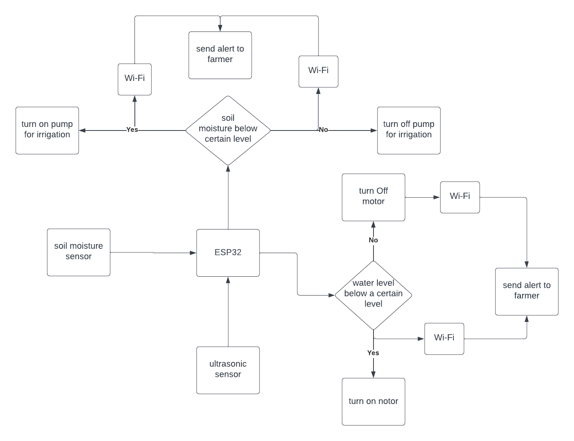

Slide 8
Benefits of automatic irrigation
The benefits of automatic irrigation are:
reduced labour
timely irrigation — plants being watered when needed
management of higher flow rate
saccurate cut-off of water compared to manual checking
reduced runoff of water and nutrients
reduced costs for vehicles used to check irrigation.

Slide 9
Disadvantages of automatic irrigation
The disadvantages of automatic irrigation are:
costs for purchasing, installing and maintaining the equipment
reliability of irrigation system (due to human error when setting up)
increased maintenance of channels and equipment to ensure it is working properly

Slide 10
THANK YOU

